Slide 1
Threat Analysis in cloud: Attacks and solutions
Module 2
Cloud computing
Dr Bijoy A Jose

Slide 2
Cyber Security Objectives
Confidentiality: Prevention of unauthorized access to resources
Integrity: Prevention of modification or corruption of resources
Accessibility: Prevention of attacks that would keep a resource from being accessed or used according to its intended function

Slide 3
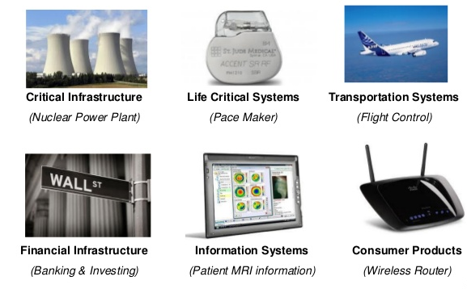
Why should embedded security be important ?

Slide 4
Why embedded security difficult ?
Economic/Business incentive to produce bad security products: Oftentimes buyers are unable to observe the differences in quality between a good security products
Increased software complexity: Linear growth in hardware/software content creates non-linear growth in overall system complexity.
Security is an afterthought: Often financially and/or technically infeasible to retrofit security capabilities to an embedded system that was not originally designed for it

Slide 5
Cyber attacks
What are the types of attacks
What are the solutions?
How is the attack performed?

Slide 6
Physical attacks
Simplest method to attack a device or server
Tamper or replace edge/server
Remove connectivity
-> Needs access to device/server
-> Server need not be physically accessible if it is in cloud
Solution
Lock and key
Limit the people who can tamper with device.

Slide 7
Encryption attacks
Getting hold of encryption key and use for later time to hack
  When the IoT network was unencrypted
  Zero day attack: When the vulnerability was unknown.
  Brute force attack to crack encryption
  Session hijacking
Solutions
-> system has to start with encryption in place
->Encryption mechanism should not transfer key over the network.
-> Use the latest encryption standards to withstand brute force attack
-> Detect attack attempts and flag users

Slide 8
Denial of Service (DoS)
DoS or Distributed DoS
It is a DoS attack, if a service has become unavailable as a result.
Can be caused due to large number of calls to service by Bots.
Impact is to bring a business down
Solutions
Keep changing ip address of servers and filter all requests coming in
  Eg; Cloudflare
Duplicate servers, rate limiting, etc.

Slide 9
Eavesdropping
Hacker intercepts network traffic in order to steal sensitive information via a weakened connection between an IoT device and a server.
Eavesdropping is typically done by listening to digital data transfer, or voice communication or via the interception of sniffed data.
Eg: snooping, keylogging
Solutions
No physical access to edge device
Strong encryption in network and strong protocols in place

Slide 10
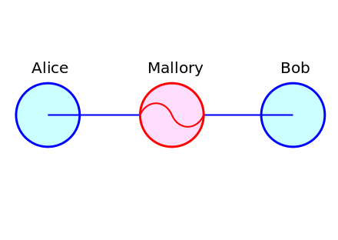
Man in the Middle attack
Alice "Hi Bob, it's Alice. Give me your key." → Mallory Bob
Alice Mallory "Hi Bob, it's Alice. Give me your key." → Bob
Alice Mallory ← [Bob's key] Bob
Alice ← [Mallory's key] Mallory Bob
Alice "Meet me at the bus stop!" [encrypted with Mallory's key] → Mallory Bob
Alice Mallory "Meet me at the van down by the river!" [encrypted with Bob's key] → Bob

Slide 11
Man in the Middle (MITM)
Hacked has breached communication between two entities
Tricking an edge/server by impersonation
ARP spoofing by IP impersonation in a network. Give wrong Mac address+ IP combination to edge device
Solution
Certificate authority for websites
Multi-factor authentication
VPN or secure networks

Slide 12
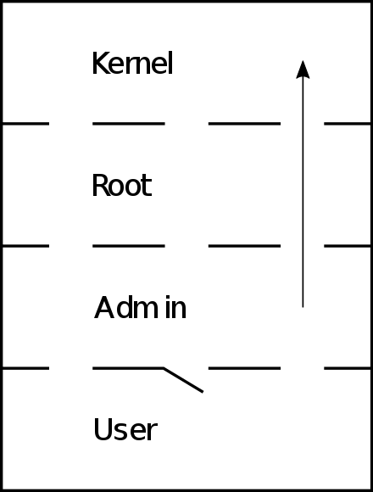
Privilege Escalation/jailbreaking
Legitimate access may be given, but higher privilege is requested to do unauthorized changes or steal data.
Access maybe given by mistake, due to bug or design flaw.
Typically memory based attack. Eg: buffer overflow
Solutions
Memory protections techniques

Slide 13
Firmware hijacking
In IoT, new firmware fixes bugs and vulnerabilities. Not updating makes you exposed
Updates have to come from the right source. Malicious software update can result in hijacking as privilege is high during update.
Eg: Connecting bad USB
Solutions
Secure boot – Only update from OEM
Enhanced BIOS verification – compage BIOS image with official image

Slide 14
How to attack? Ransomware and Botnets
Ransomware is a type of malware that locks down access to files by encrypting them.
Disrupt day-to-day business and the encryption key often comes at a hefty price.
Botnets: Turn networked IoT devices into remotely controlled bots to transfer private, sensitive corporate data, which may be sold on the dark web, or to disable a device.
  Eg: Mirai botnet hacked 2.5 million devices to create DoS type attack.

